Slide 1
Presentation of Trefler and Romalis papers
11/05/2021
International economics
BAI Minxuan
BARDI VALE Yago Alessandro CITROËN Gaspard
DÉCLOUX-CARRÉ Marion

Slide 2
1. The Trefler paper

Slide 3
“The Case of the Missing Trade & other Mysteries” (1995)
By Daniel Trefler
Explain HOV Theorem
Propose alternative theorems
Discuss limitations
1
3
5
2
4
Show empirical rejection of HOV theorem
Evaluate alternative theorems

Slide 4

The Heckscher-Ohlin-Vanek theorem
If country “c” is abundant in factor “f”, it will export the goods which are “f”-intensive
$F_{fc}= V_{fc} − s_{c}$ $V_{wc}$
Assume the USA are abundant in factor “Capital”. It will export capital intensive goods
The amount of Capital the USA has
The Consumption Share of the USA
The total amount of capital in the world
Capital used to produce the net Exports of USA
-
=
x

Slide 5
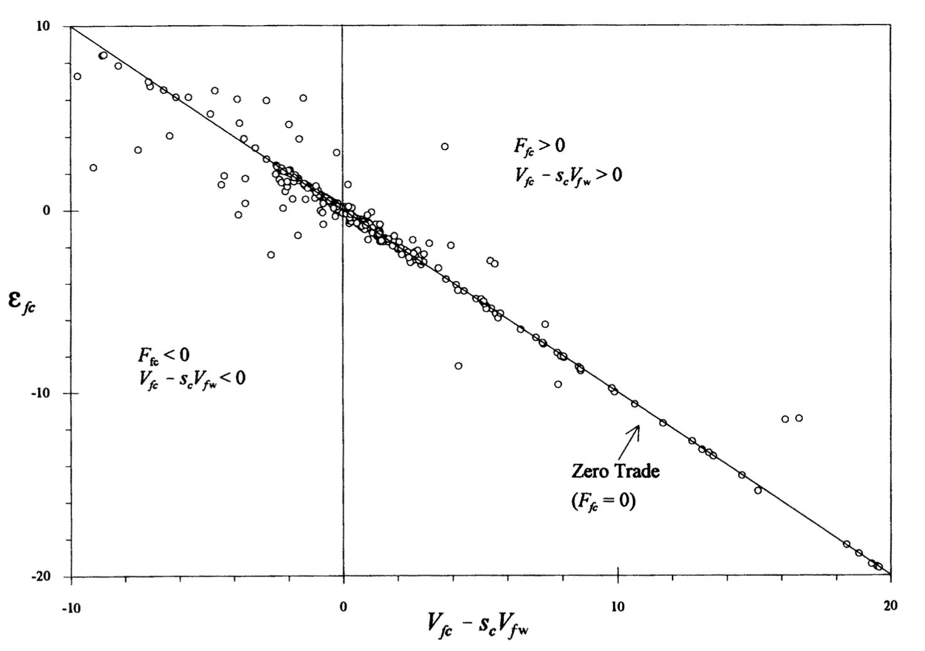
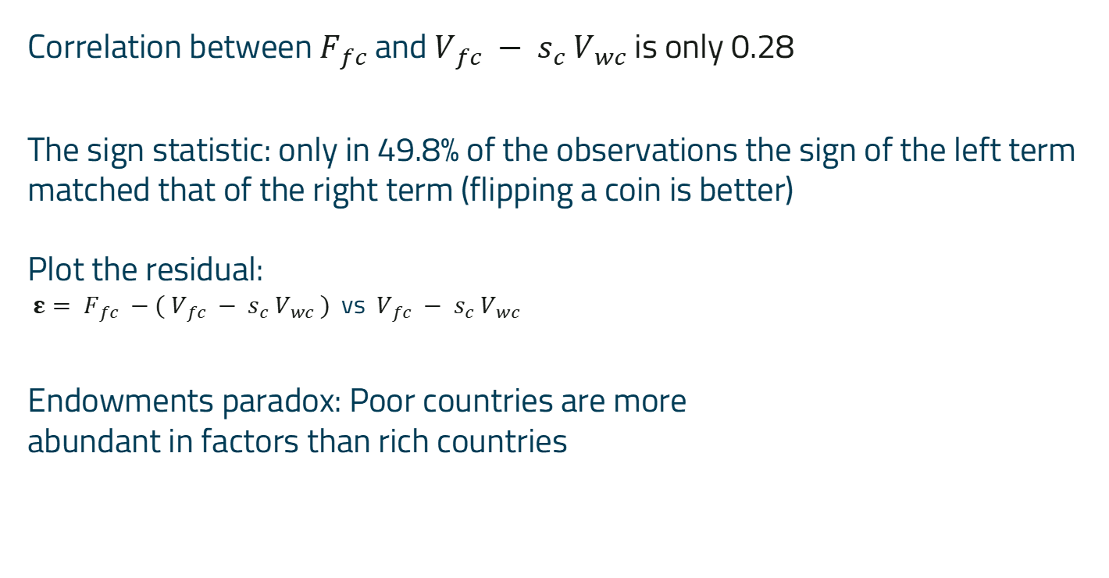
Empirical rejection
Correlation between $F_{fc}$ and $V_{fc} − s_{c}$ $V_{wc}$is only 0.28
The sign statistic: only in 49.8% of the observations the sign of the left term matched that of the right term (flipping a coin is better)
Plot the residual:
${ε= F}_{fc} −( V_{fc} − s_{c}$ $V_{wc} )$ vs $V_{fc} − s_{c}$ $V_{wc}$
Endowments paradox: Poor countries are more
abundant in factors than rich countries
+
-
Notes:
The sign statistic: if the sign of both sides of the equation is the equal, the model can atleast predict if the country exports or imports the given good based on factor endowment.

Slide 6
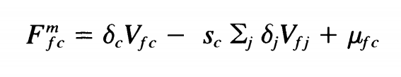
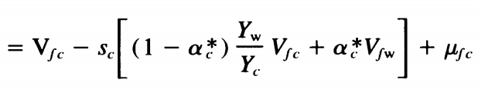

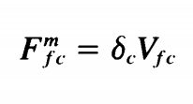
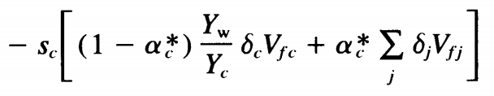

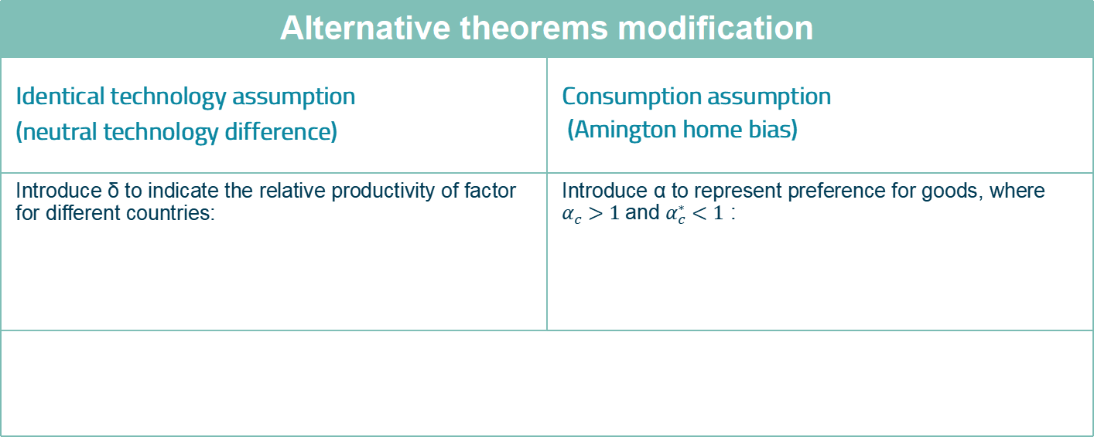
Alternative theorem
Empirical rejection proves the existence of “missing trade”
The reason of the puzzle lies into the assumptions of HOV model.
Alternative theorems modification
Identical technology assumption (neutral technology difference) | Consumption assumption (Amington home bias)
Introduce δ to indicate the relative productivity of factor for different countries: | Introduce α to represent preference for goods, where $α_{c}>1$and $α_{c}^{∗}<1$ :
Alternative theorems modification
Identical technology assumption (neutral technology difference) | Consumption assumption (Amington home bias)
Introduce δ to indicate the relative productivity of factor for different countries: | Introduce α to represent preference for goods, where $α_{c}>1$and $α_{c}^{∗}<1$ :
Notes:
The sign statistic: if the sign of both sides of the equation is the equal, the model can atleast predict if the country exports or imports the given good based on factor endowment.

Slide 7
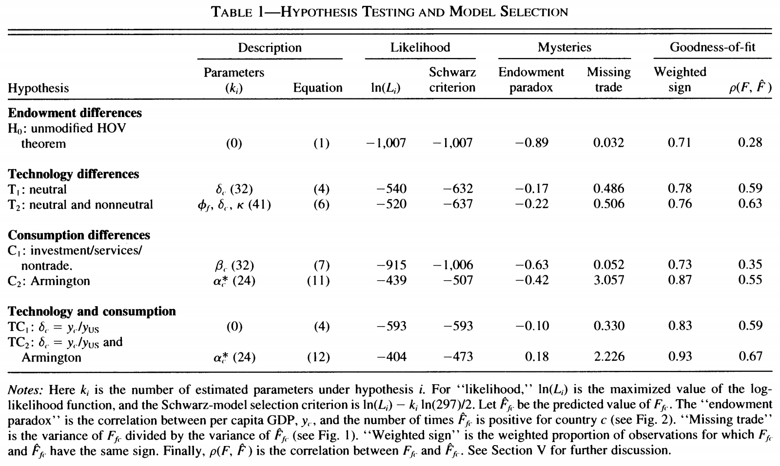
Evaluation of alternative theorem
Correlation rise from 0.28 to 0.67
the success rate of the sign-test goes up to 72%, compared with 49%
+
-
Notes:
The sign statistic: if the sign of both sides of the equation is the equal, the model can atleast predict if the country exports or imports the given good based on factor endowment.

Slide 8
Limitation
In conclusion, Trefler believed that the major cause of the ‘missing trade’ in the HOV model is the assumption of the identical technology and the identical preference. And he therefore built up a more reasonable alternative to the original HOV model.
But Trefler still indicates some limitation. First, we have to avoid the data instigation on hypotheses; Second, work is needed to explain why endowment similarity is associated with poor predictions; Third, we still need more detailed data to investigate further the sources of international productivity differences and Armington home bias.
Notes:
The sign statistic: if the sign of both sides of the equation is the equal, the model can atleast predict if the country exports or imports the given good based on factor endowment.

Slide 9
2. The Romalis paper

Slide 10
“Factor Proportions and the Structure of Commodity Trade” (2004)
By John Romalis
Author and hypothesis
Empirical data
Empirical data
1
3
5
2
4
The quasi Heckscher-Ohlin prediction
The quasi-Rybczynski prediction

Slide 11

Author and hypothesis
John Romalis, economist in international trade and international macroeconomics
Currently affiliated to the Univerity of Sidney
Published in 2004 in the American Economic Review
Hypothesis :
Transport costs
Monopolistic competition

Slide 12
The quasi Heckscher-Ohlin prediction
Explanation of the theory
Countries capture larger shares of world production and trade in commodities that more intensively use their abundant factor.
For example, countries that are abundant in skilled labor and capital do capture larger shares of US imports in industries that intensively use those factors.

Slide 13
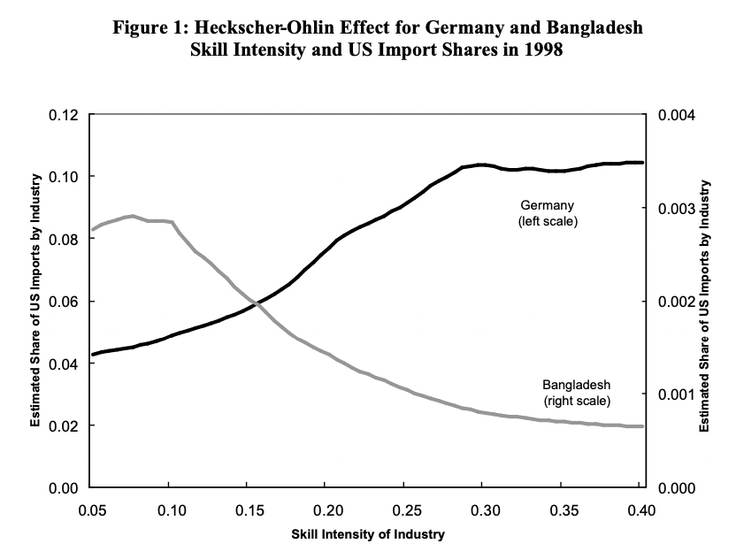
The quasi Heckscher-Ohlin prediction
Example of Germany and Bangladesh
Germany, where the average adult has in excess of ten years of formal education, captures large shares of U.S. imports of skill-intensive commodities, and much smaller shares for commodities that sparingly use skilled labor.
Bangladesh, where the average adult has just two and a half years of formal education, exhibits the opposite trade pattern, with exports concentrated in commodities that require little skilled
labor.

Slide 14
The quasi-Rybczynski prediction
Explanation of the theory
Countries that accumulate a factor faster than the rest of the world will see their production and export structure move towards commodities that more intensively use that factor
Factor proportions appear to be an important determinant of the structure of production and international trade
Reminder of the Rybczynski theorem → An increase in the relative endowment of a factor leads to a more than proportionate increase in the output of the good that uses that factor relatively intensively

Slide 15
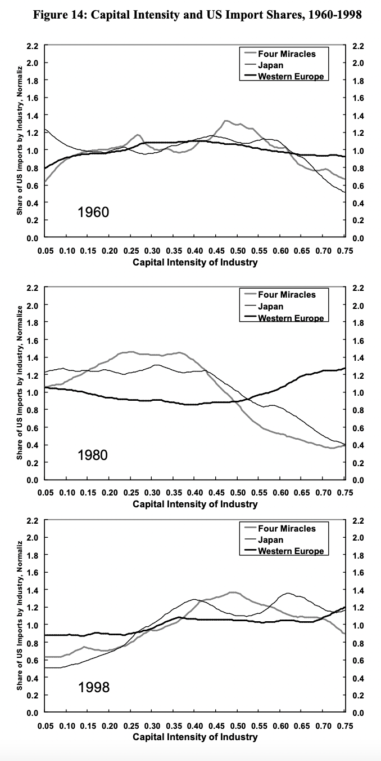
The quasi-Rybczynski prediction
Rapidly growing countries have seen their export structure change towards more skill and capital intensive industries
As the relative income levels of the economies converged, so too did their production structures
There is a development path that all countries follow as we can see with Japan or the “Four Miracles”

